Slide 1
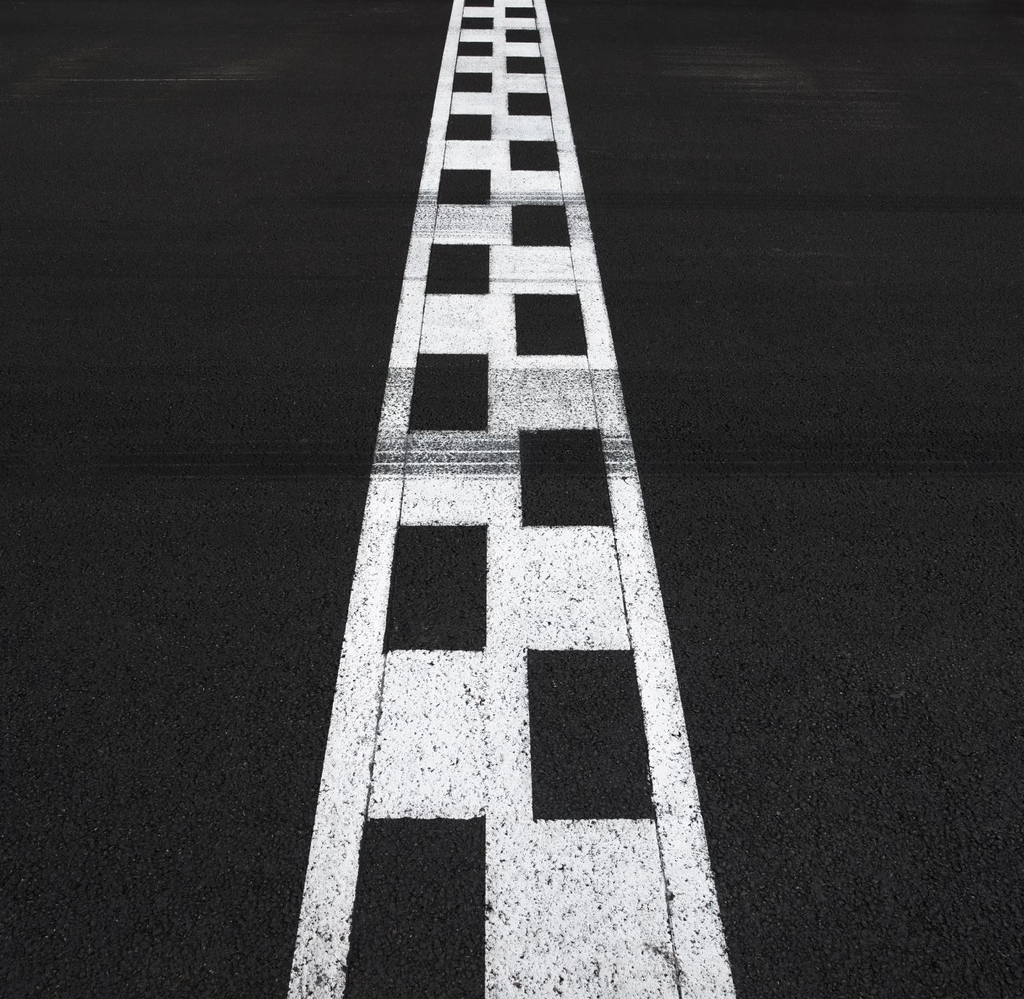
Road Lane Detection
Group Members :
Amal Reghunath
Anirudh Nair
Arjun P Dinesh

Slide 2
Introduction
Automated driving systems may help to reduce the huge number of human fatalities and injuries resulting from car accidents .
The road lane detection algorithm is one of the key technologies in such a system.
This paper presents a robust and effective approach to extracting the location of road marking. It is based on taking a top view of the image in a region of interest (ROI), and is termed inverse perspective mapping (IPM).

Slide 3
Abstract
Lane detection is a developing technology that is implemented in vehicles to enable autonomous navigation.
The existing lane detection system are designed for roads with proper structure relying on markings
Our main aim is to obtain a real time curve value to assist the driver/autonomous vehicle for taking required turns and not go off the road.
In this study one such approach for detecting lanes on a marked road is reviewed followed by an improved approach

Slide 4
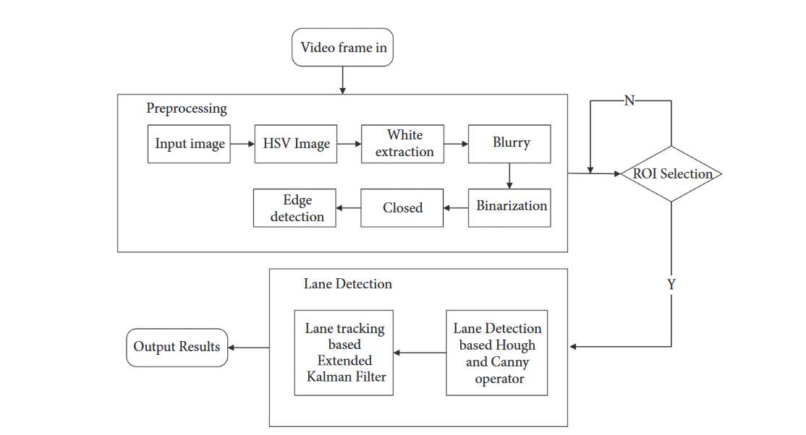
Methodology Diagram

Slide 5
Methodology
Preprocessing : Improve the quality of Image
Techniques used: Smoothing and filtering graphics
Low-pass or High-pass Filtering
Colour Transform: Converts the RGB colour frames to HSV colour frames

Slide 6

Basic Preprocessing : The images are individually gray scaled, blurred, X-gradient calculated , Y-gradient calculated, global gradient calculated, thresh off-frame, and morphological closure
Adding Colour Extraction in Preprocessing : Adding a feature extraction module

Slide 7

Adding Edge Detection in Pre-processing : This section mainly performs the overall edge detection on the frame image using the improved canny edge detection
ROI Selection: Selecting a Region Of Interest area on the input in order to remove unnecessary regions

Slide 8
Edge Detection: Edge detection is an image processing technique for finding the boundaries of objects within images.
Techniques used: Canny Transform
Sobel Transform
Laplacian Transform

Slide 9
Lane Detection
Feature based Methods: To detect the colour and edge features of Lanes in order to improve the accuracy and efficiency of lane detection
Two Methods:
Hough Transform: used to extract lane line parameters in each frame of the image sequence for lane detection
Self-Programming: ROI area is traversed to perform line detection for a specific range of angles

Slide 10
Lane Tracking Using Extended Kalman Filter : Tracking of lane
Extended Kalman Filter is used to track these parameters one by one

Slide 11

Conclusion
We proposed a new lane detection preprocessing and ROI selection methods to design a lane detection system. Edge extraction has also been added during the preprocessing stage to improve lane detection accuracy. We also placed the ROI selection after the proposed preprocessing. Compared with selecting the ROI in the original image, it reduced the non-lane parameters and improved the accuracy of lane detection. Currently, we only use the Hough transform to detect straight lane and EKF to track lan

